Slide 1
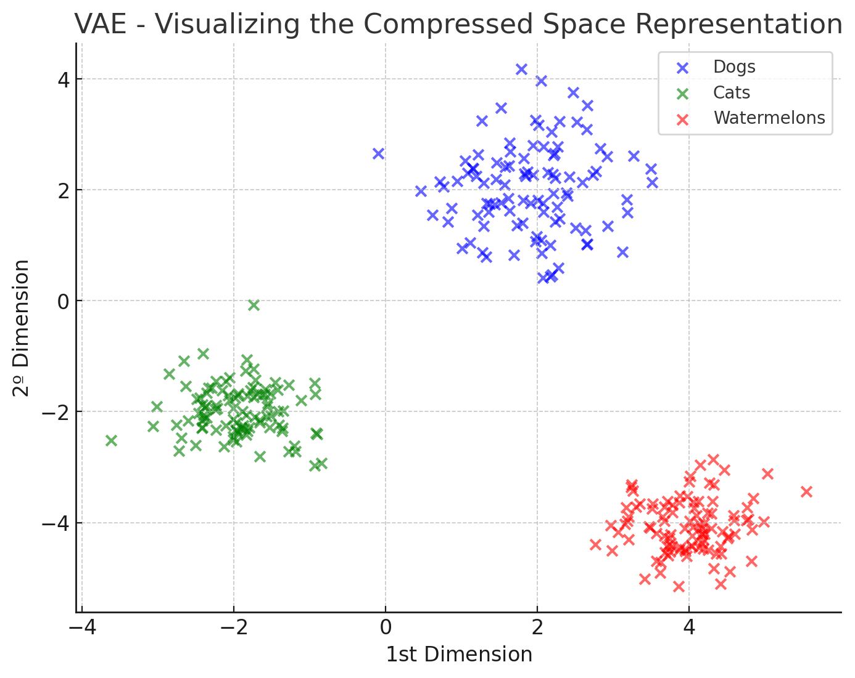
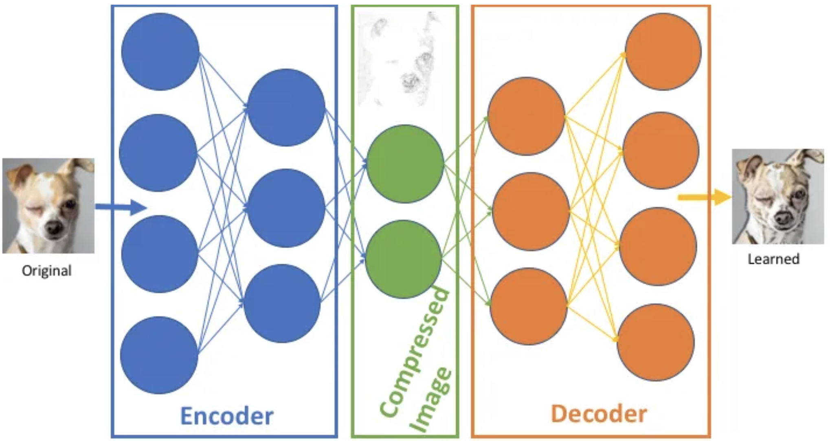
Image Generation - early days
VAEs - Variational Auto-Encoders (2013)

Slide 2
Image Generation - early days
VAEs - Variational Auto-Encoders (2013)

Slide 3
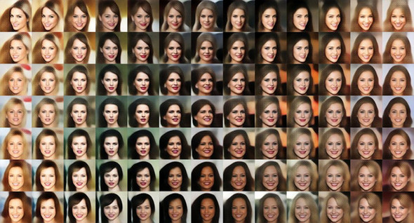
Image Generation - early days
VAEs - Variational Auto-Encoders (2013)
A dataset of faces generated by Tom White using VAEs

Slide 4
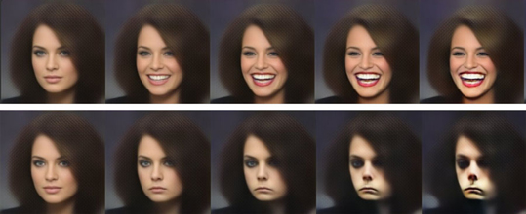
Image Generation - early days
VAEs - Variational Auto-Encoders (2013)
The smile vector
example taken from: https://gaussian37.github.io/deep-learning-chollet-8-4/

Slide 5
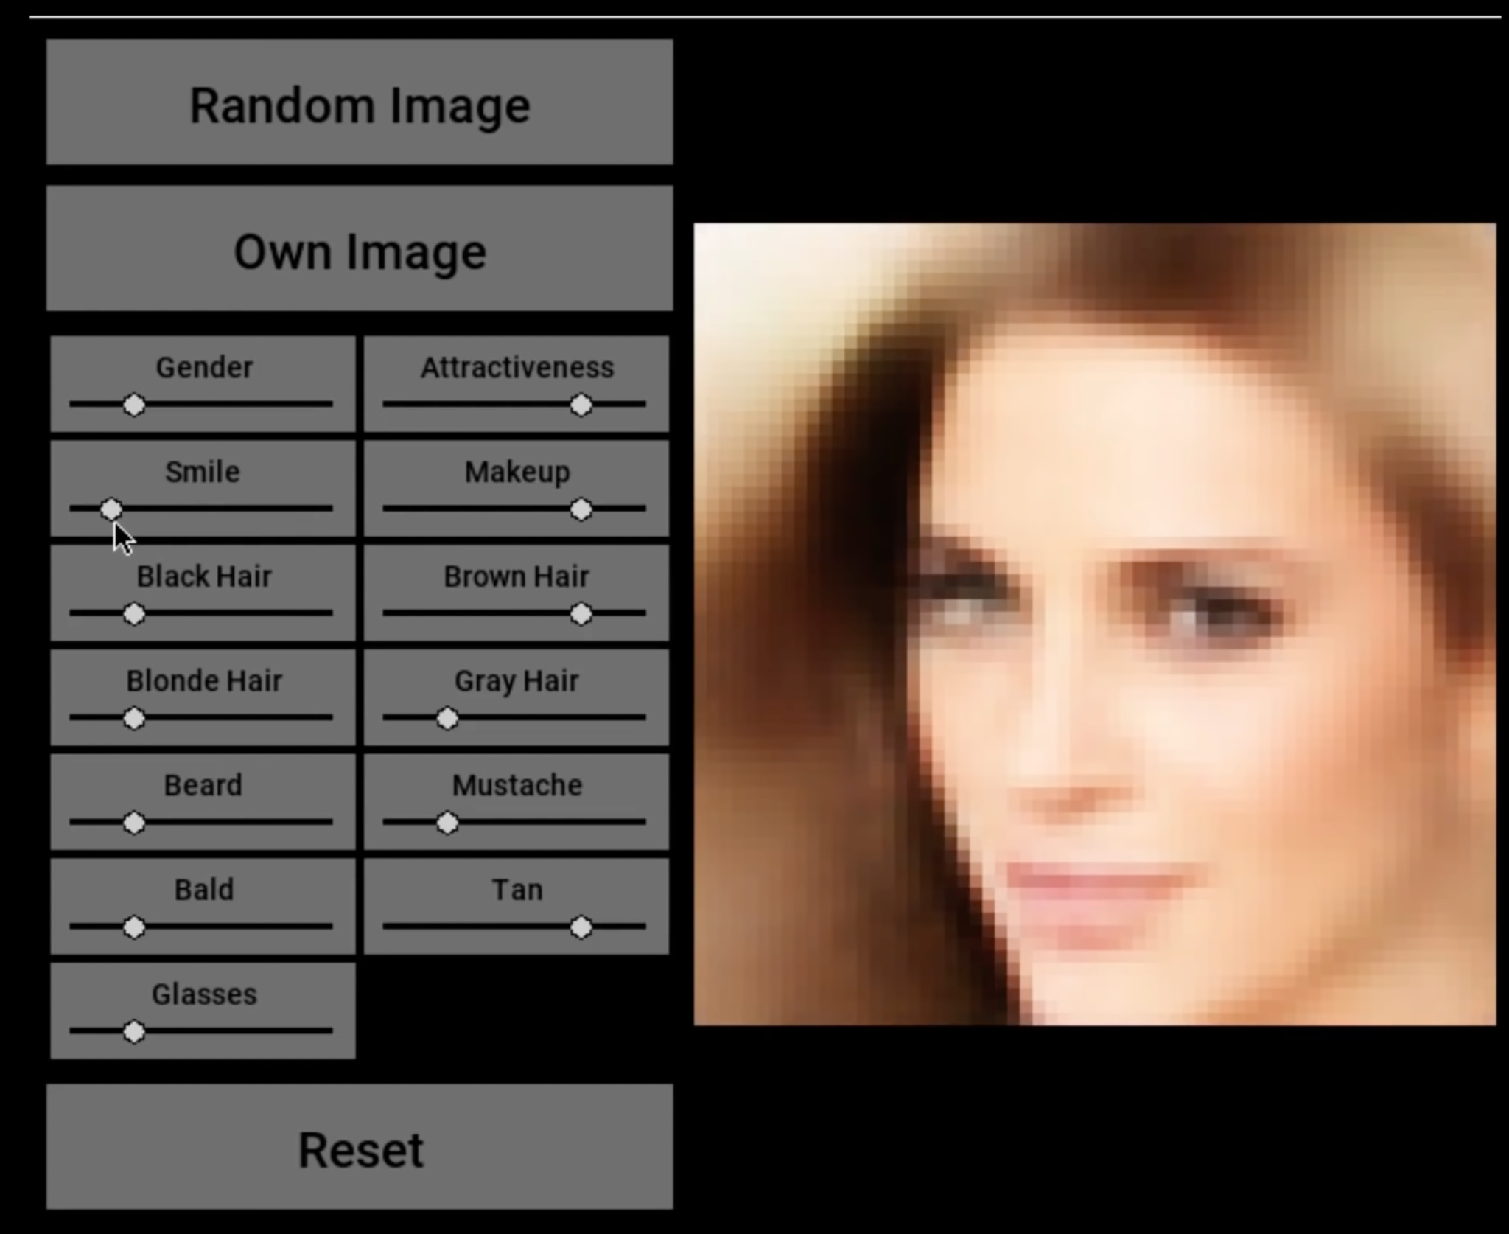
New Image applications emerge (2014+)
Image editing and manipulation

Slide 6
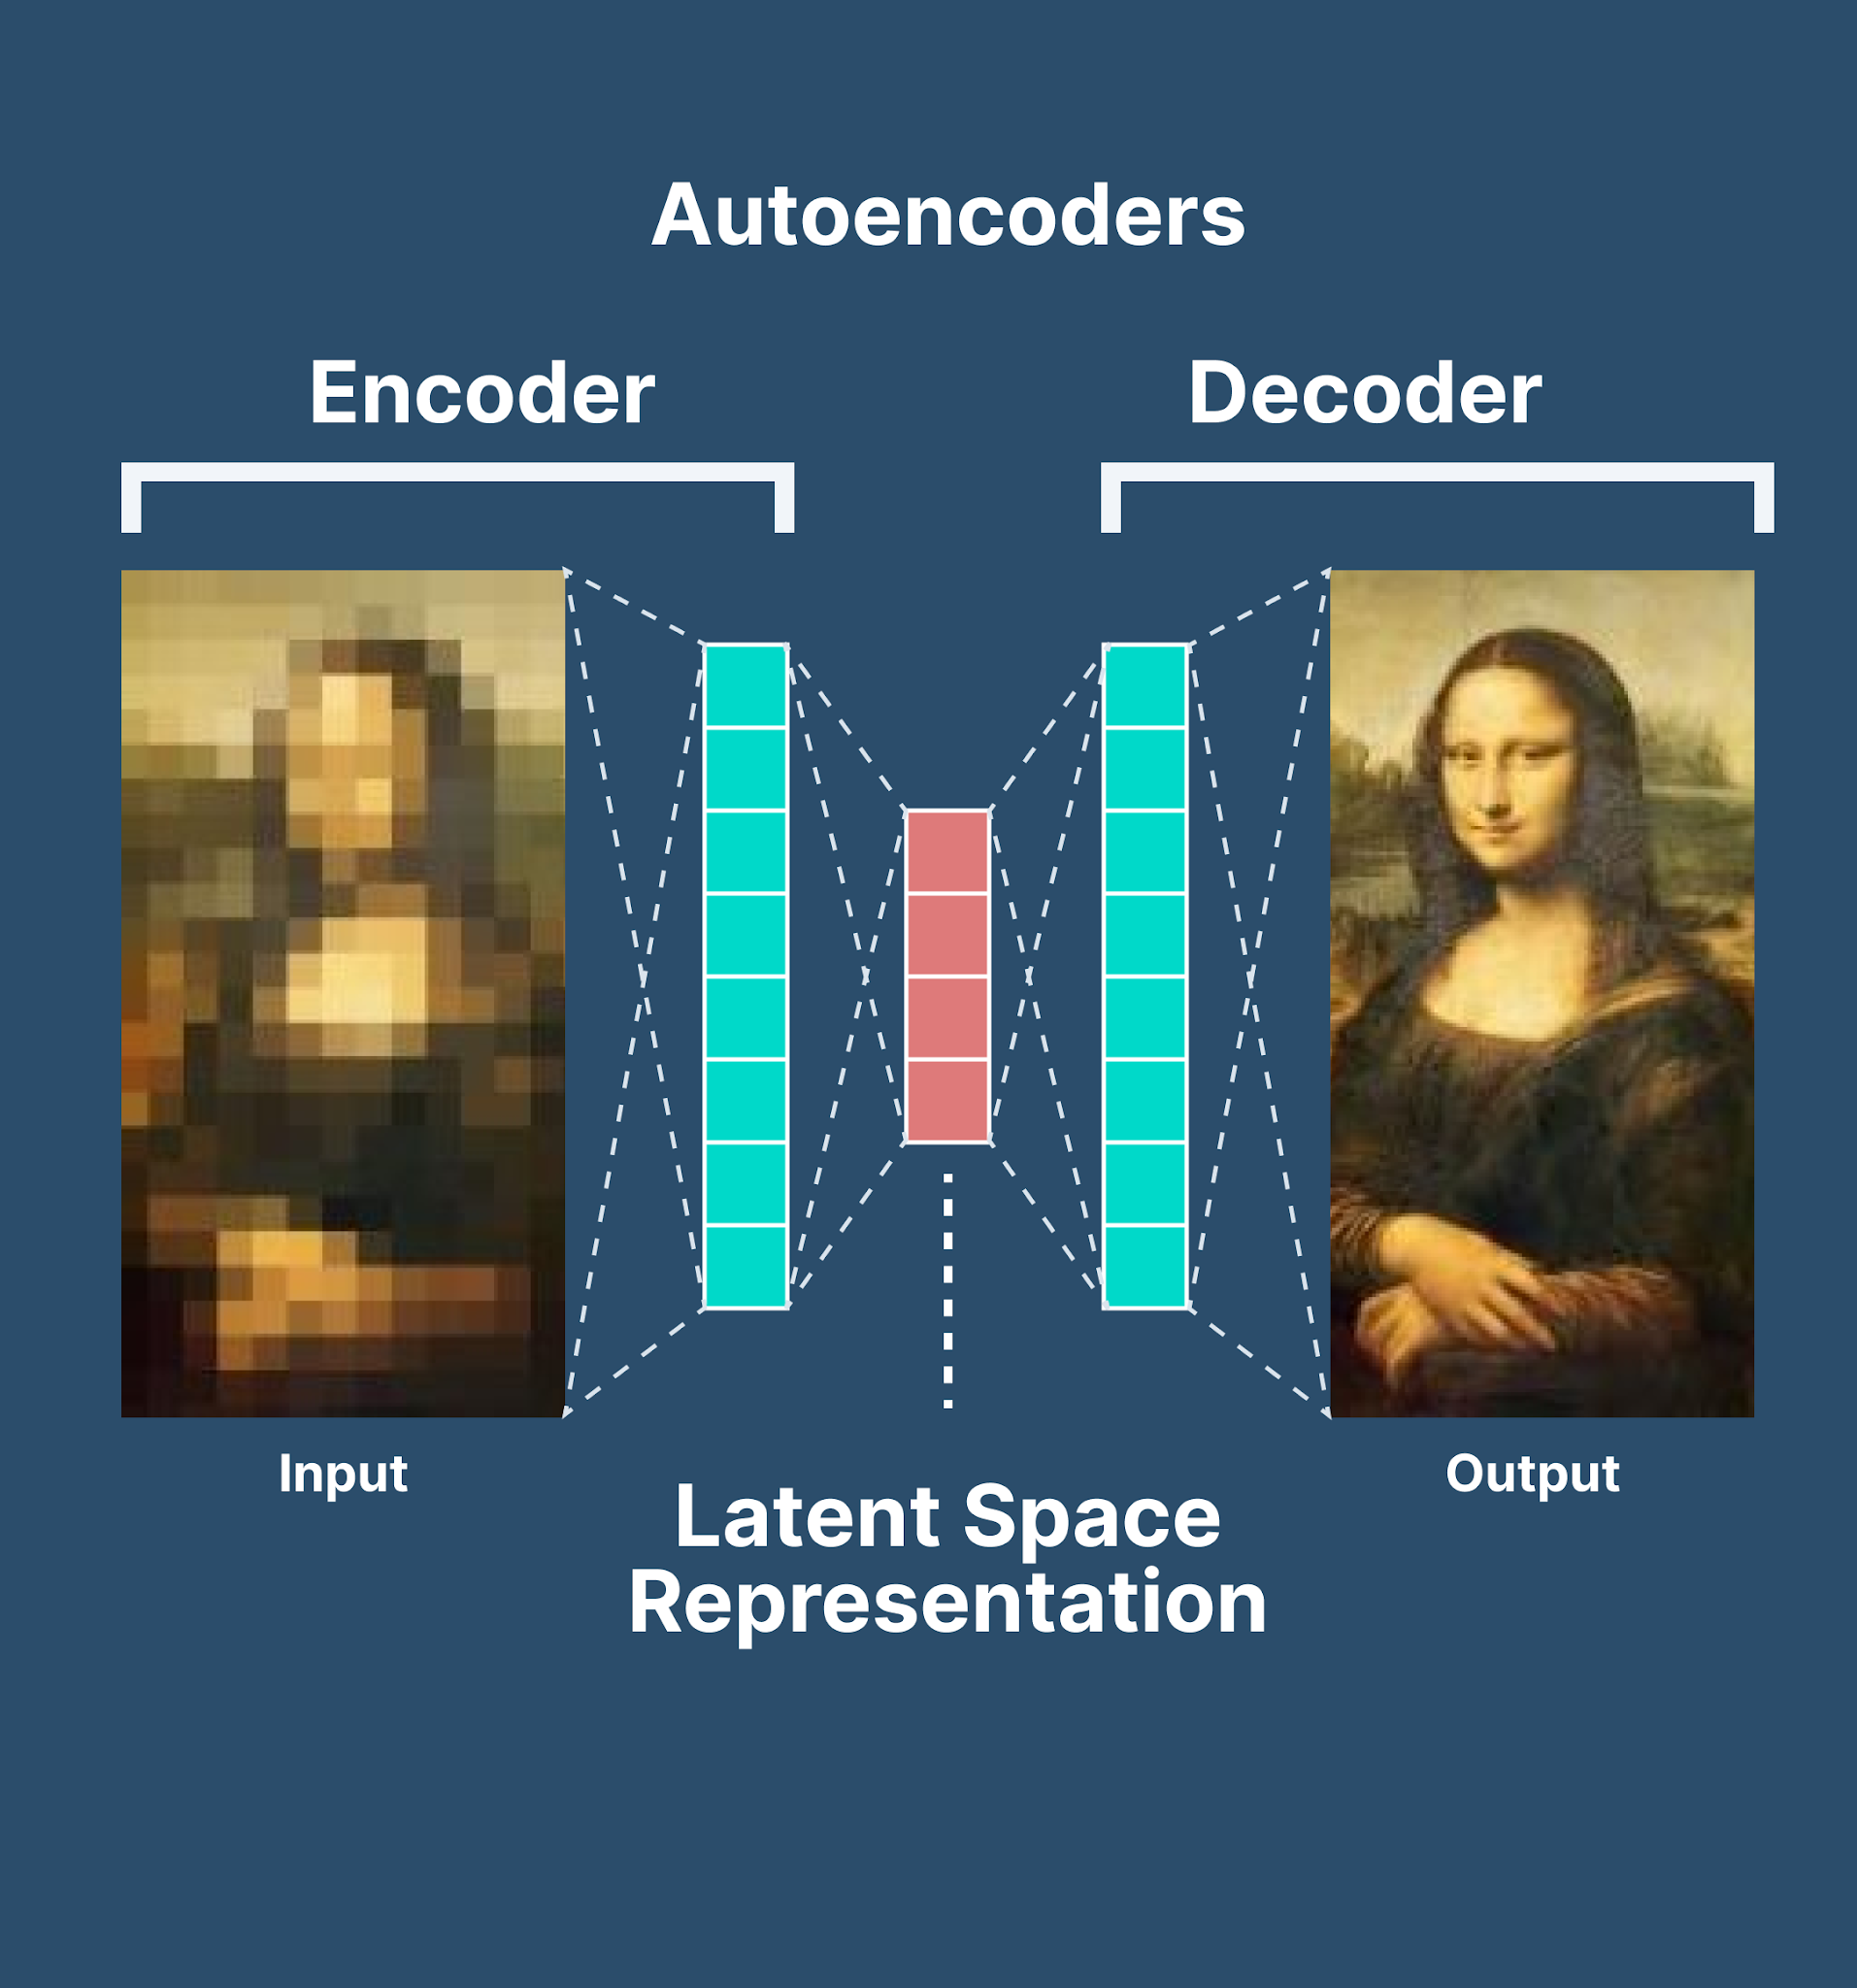
New Image applications emerge (2014+)
Image Reconstruction

Slide 7
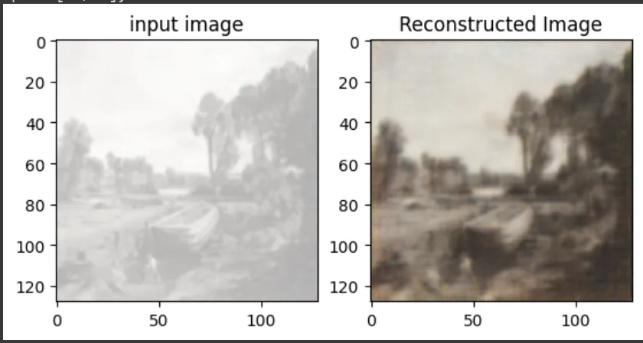
New Image applications emerge (2014+)
Image Reconstruction

